Slide 1
Minor Project
Diabetes data set It consist of variables like Pregnancies, Glucose, Blood Pressure, Skin Thickness, Insulin, BMI, Diabetes Pedigree, Function, Age, Outcome.
Outcome is the target variable. It has 768 rows and 9 columns.
.

Slide 2
It has 768 rows and 9 columns
 |  | Pregnancies | Glucose | BloodPressure | SkinThickness | Insulin | BMI | DiabetesPedigreeFunction | Age | Outcome
 | count | 768.000000 | 768.000000 | 768.000000 | 768.000000 | 768.000000 | 768.000000 | 768.000000 | 768.000000 | 768.000000
 | mean | 3.845052 | 120.894531 | 69.105469 | 20.536458 | 79.799479 | 31.992578 | 0.471876 | 33.240885 | 0.348958
 | std | 3.369578 | 31.972618 | 19.355807 | 15.952218 | 115.244002 | 7.884160 | 0.331329 | 11.760232 | 0.476951
 | min | 0.000000 | 0.000000 | 0.000000 | 0.000000 | 0.000000 | 0.000000 | 0.078000 | 21.000000 | 0.000000
 | 25% | 1.000000 | 99.000000 | 62.000000 | 0.000000 | 0.000000 | 27.300000 | 0.243750 | 24.000000 | 0.000000
 | 50% | 3.000000 | 117.000000 | 72.000000 | 23.000000 | 30.500000 | 32.000000 | 0.372500 | 29.000000 | 0.000000
 | 75% | 6.000000 | 140.250000 | 80.000000 | 32.000000 | 127.250000 | 36.600000 | 0.626250 | 41.000000 | 1.000000
 | max | 17.000000 | 199.000000 | 122.000000 | 99.000000 | 846.000000 | 67.100000 | 2.420000 | 81.000000 | 1.000000

Slide 3
These are number of zeros in each data variable after removing zeros we have 392 rows × 9 columns
Pregnancies 111
Glucose 5
Blood Pressure 35 SkinThickness227
Insulin 374
BMI 11
DiabetesPedigreFunction0
Age 0

Slide 4
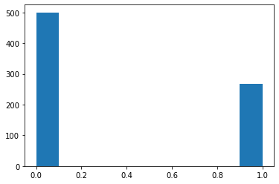
Here we can see the 0(negatives) are high and 1(positives) are less. 0 are 500 and 1 are 268.
500

Slide 5
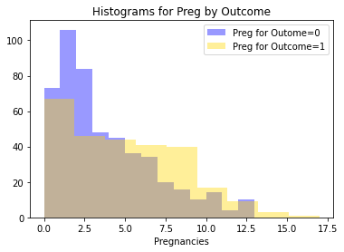
When looking at the histogram, a hypothesis is the as pregnancies includes, women are more likely to be diabetic.

Slide 6
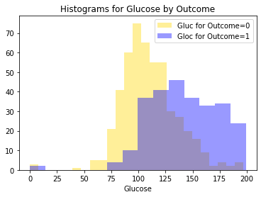
Clearly diabetic group has higher glucose than non-diabetic.

Slide 7
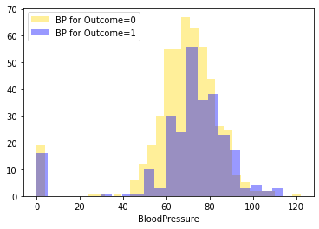
Diabetic women seems to have high BP.

Slide 8
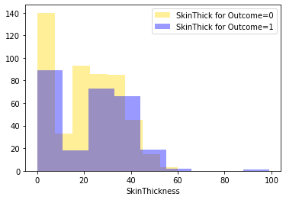
Like BP, people who are not diabetic have lower skin thickness.

Slide 9
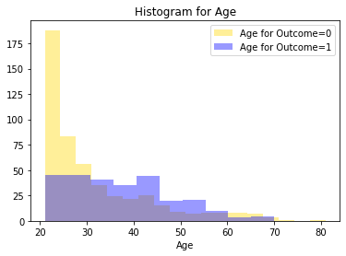
There is a tendency that as people age, they are likely to become diabetic.

Slide 10
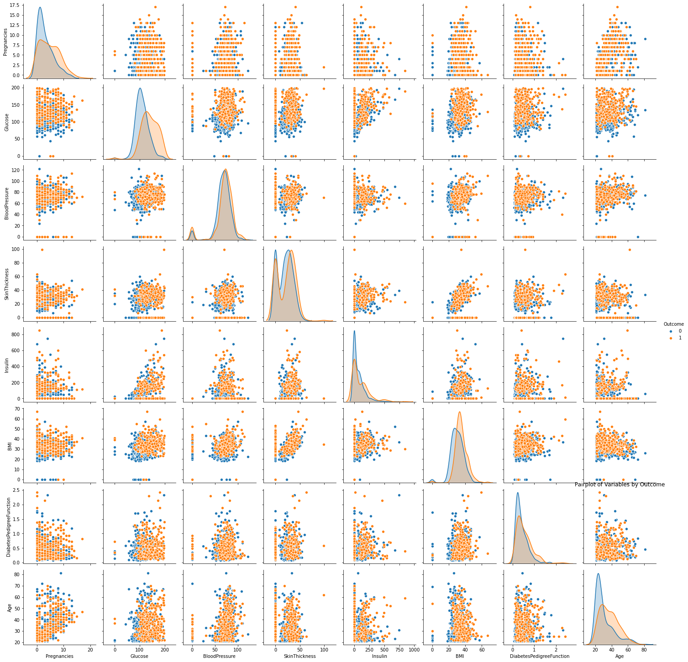
From scatter plots, BMI & SkinThickness and Pregnancies & Age seem to have positive linear relationships. Another likely suspect is Glucose and Insulin.

Slide 11
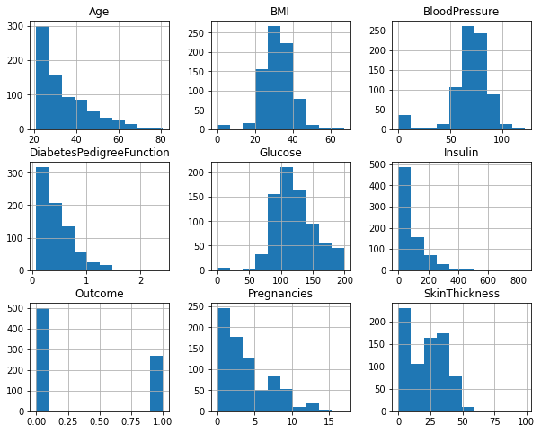
Here we can see the counts of each individual.

Slide 12
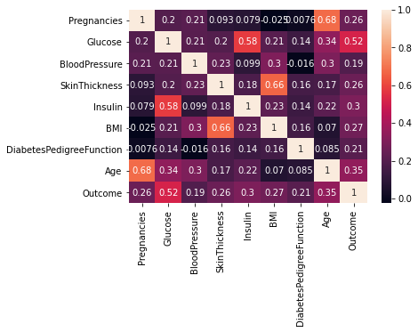
Age & Pregnancies and BMI & Skin Thickness have moderate positive linear relationship

Slide 13
Here we applied Logistic Regression for prediction and we can see confusion matrix.
 | positive | negative
Predicted positive | 98(true positive) | 9(false positive)
Predicted negative | 18(false negative) | 29(true negative)
Here we can see 18 false negatives which are at high risk.

Slide 14
Thank you.

